Slide 1
Relocation to Germany - Presentation
IBM Data Science Certification - Capstone Project

Slide 2

Business Problem - Relocating to Germany
Our client Andrea, wants to move to Germany for work.
However it asks for our help to choose what are the best cities to relocate to.

Slide 3
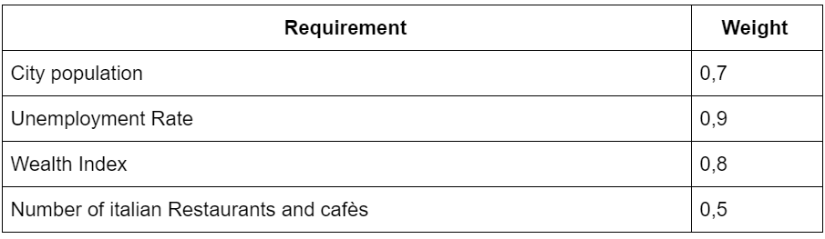
Business Problem - Relocating to Germany
Requirements defined by Andrea, with the relative weight of each requirement:

Slide 4
Data - Relocating to Germany
Population data for cities with more than 100’000 citizens, from Wikipedia
Wealth Index Data (GDP and Household Income), from Wikipedia
Unemployment Rate, per German State, from Wikipedia
German city venues, from the Foursquare API

Slide 5
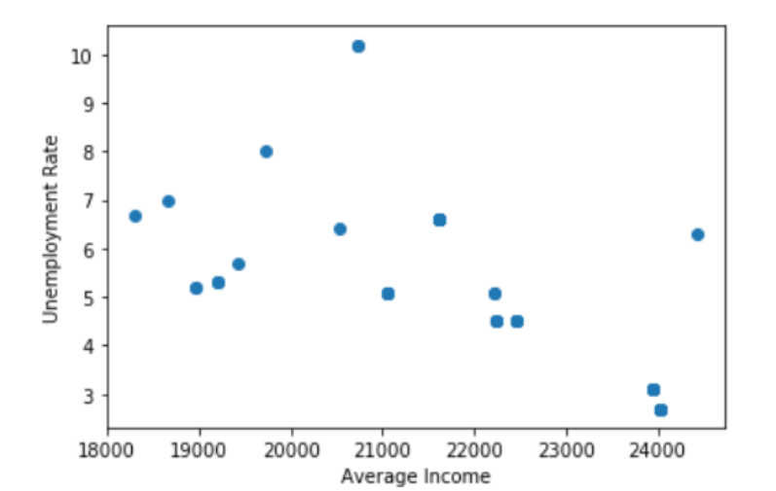
Methodology - Relocating to Germany
Exploratory Data Analysis on Employment and Average income

Slide 6
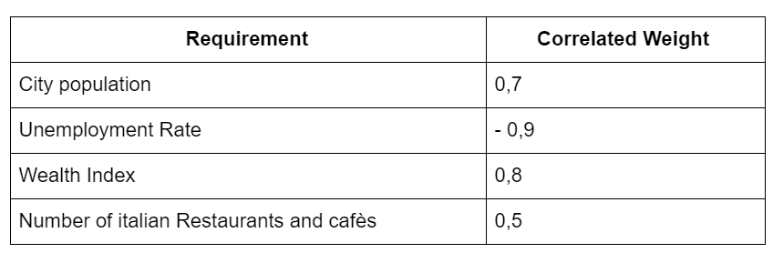
Methodology - Relocating to Germany
2. Refining the Requirements Matrix

Slide 7
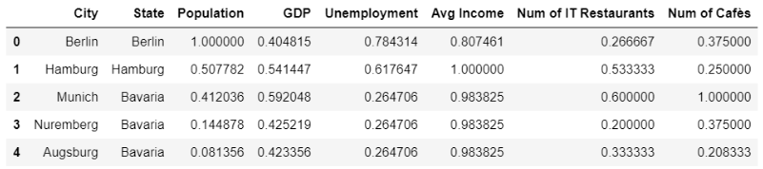
Methodology - Relocating to Germany
3. Normalizing the Features

Slide 8
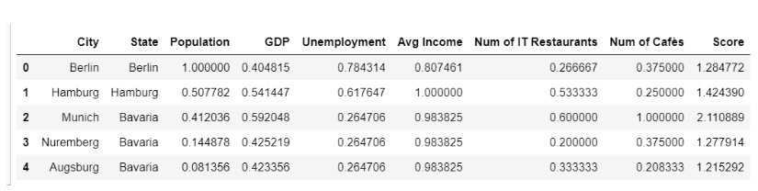
Methodology - Relocating to Germany
4. Defining a Score Index

Slide 9
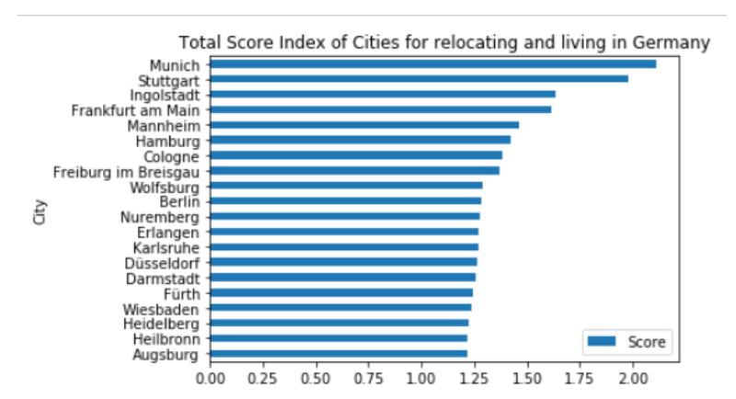
Score Index - Results

Slide 10
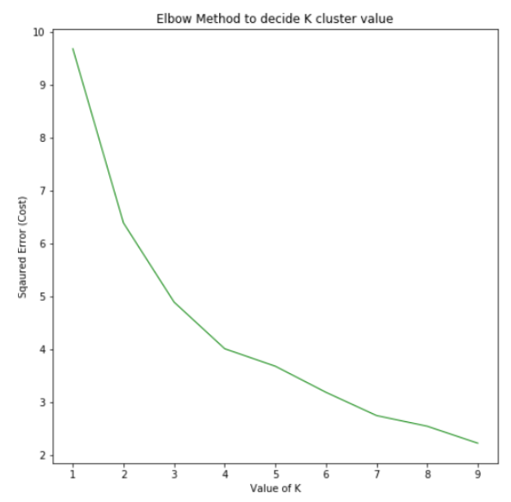
Methodology - Relocating to Germany
5. Clustering with KMeans Model.
Pick the number of clusters: 4

Slide 11
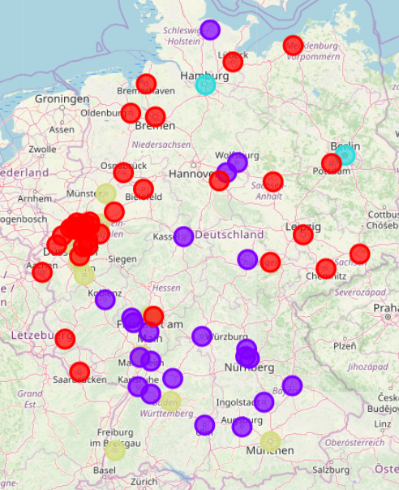
KMeans Clustering - Results

Slide 12
Results
Score Index and KMeans Clustering provided VERY similar results.
In both methods, Munich and Stuttgart were the best picks for relocating in Germany.

Slide 13
Future Direction
In order to make even more precise considerations, we could use and elaborate more data
We could use the fact that he’s an IT consultant and we would have consider the unemployment rate and the average net income for that specific job only
We could decide to use other clustering models other than the KMeans approach we’ve taken here

Slide 14
Conclusion
We gathered some data related to the biggest german cities with > 100'000 citizens from Wikipedia; this data included exact population, GDP per state, Average Employer Net Income per year and Unemployment Rate.
We obtained the number of venues of interest for our client for each city, using the Foursquare API.
We grouped these observations in one simple Dataframe, and then we normalized the data using the Simple Feature Scaling approach.
Then we used 2 methods to predict the best cities in which Andrea can relocate to: Score Index and KMeans Clustering model
Both methods showed that Munich and Stuttgart are the best cities, since they have the highest Score Index and they are grouped together in the same cluster by the KMeans model.

